Slide 1
How to Connect Computers using Network Hub to form LAN
Arnav Singhal
Div 8; Batch A8
MIS: 612203012

Slide 2
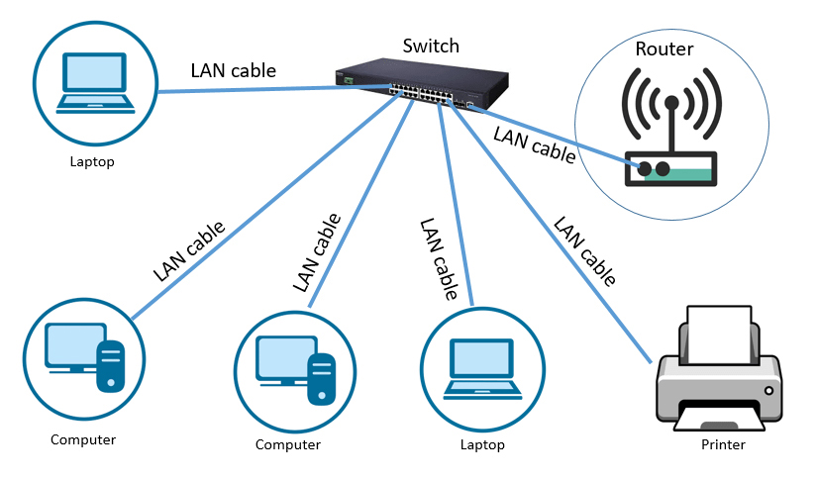
What is a LAN?
LAN stands for “Local Area Network”
Limited to a relatively small geographical area
Generally operates in a single physical location. Connects computers within a room, office, building, etc.
A typical LAN

Slide 3
Equipment Needed
Network Hub: A device to connect multiple Ethernet devices
Ethernet Cables: Sufficient cables to connect each computer to the hub
Computers: 2 to 4 computers with Ethernet ports
Power Supply: For the network hub

Slide 4
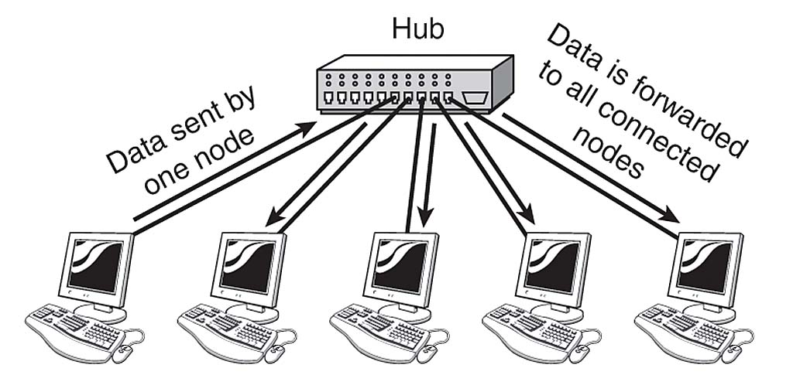
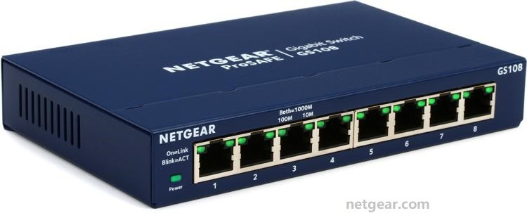
Network Hub
A hub is a network hardware device that connects multiple devices or nodes in order to share resources, information and services.
Hubs usually have 4-12 ports
When it receives a data packet at one of the ports, it sends it as electrical signals to all the other ports.
A network hub

Slide 5
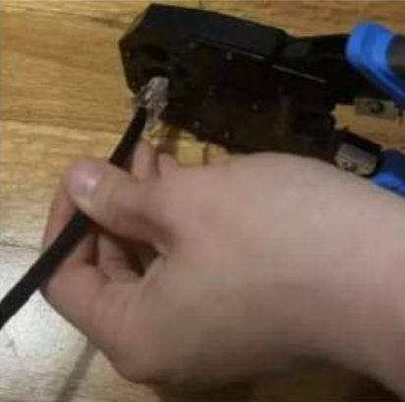
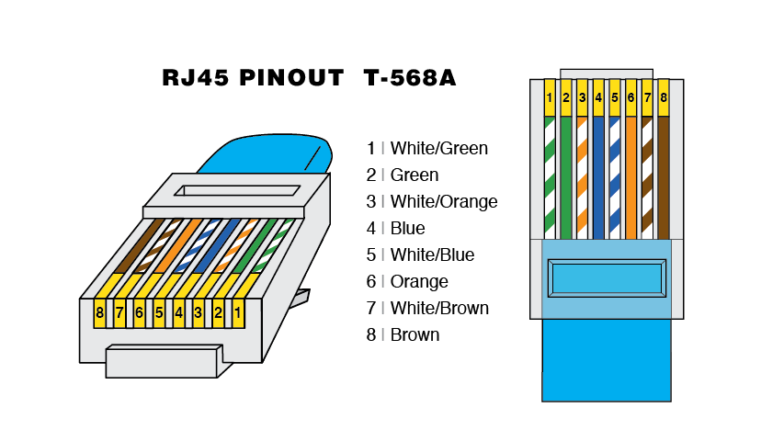
Ethernet Cables
Straight-through LAN cables required
Cables must be crimped on both ends (unless suitable readymade cables are available)

Slide 6
Steps to Create a LAN
1. Physical Setup
Place the network hub in a central location where all the computers can be easily connected
Connect the hub to power and turn it on
Take an Ethernet cable. Connect one end to the hub and the other to the Ethernet port of the first computer. Repeat this process for each of the computers.

Slide 7
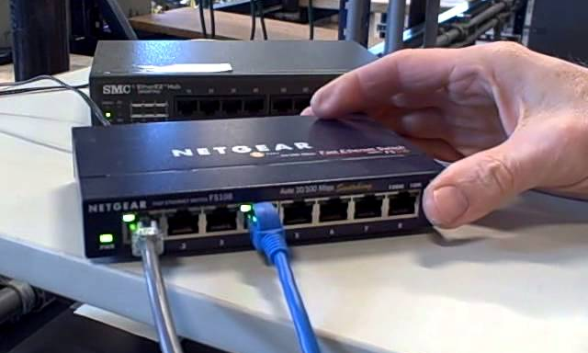
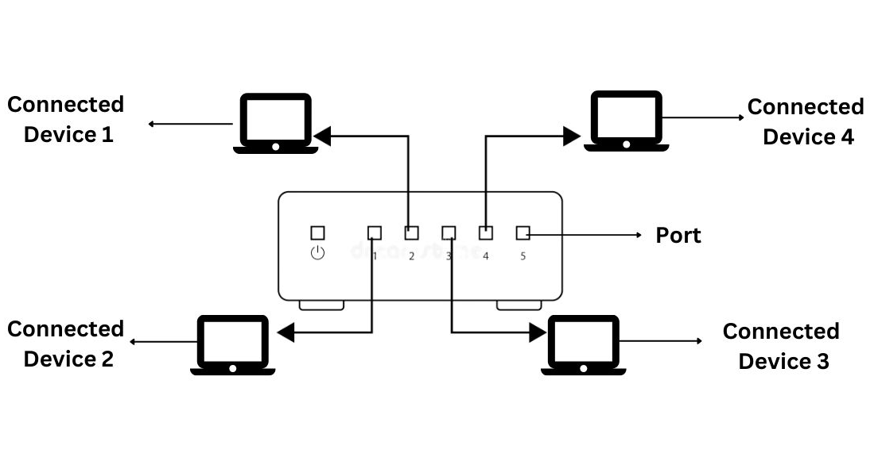
1. Physical Setup

Slide 8
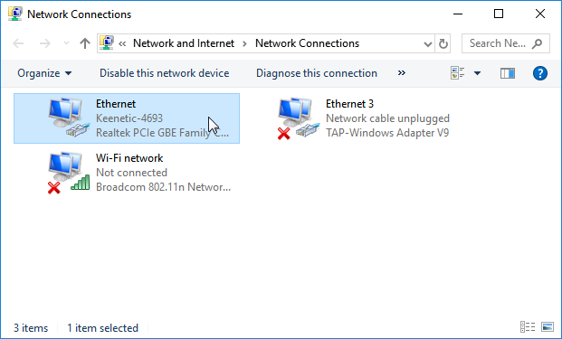
2. Network Configuration
1) Right-click the network icon in the system tray (bottom-right corner) and select "Open Network & Internet settings".
2) Click on "Change adapter options" to open the Network Connections window.

Slide 9
2. Network Configuration
3) Set IP Addresses:
Right-click on your Ethernet adapter and select "Properties".
Select "Internet Protocol Version 4 (TCP/IPv4)" and click "Properties".
Choose "Use the following IP address" and manually assign IP addresses. For example:
Computer 1: IP address: 192.168.1.1, Subnet mask: 255.255.255.0
Computer 2: IP address: 192.168.1.2, Subnet mask: 255.255.255.0
Continue in this manner for additional computers, incrementing the last digit of the IP address.
Click "OK" to save settings.

Slide 10
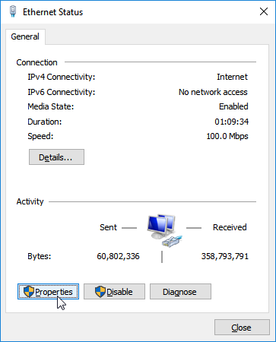
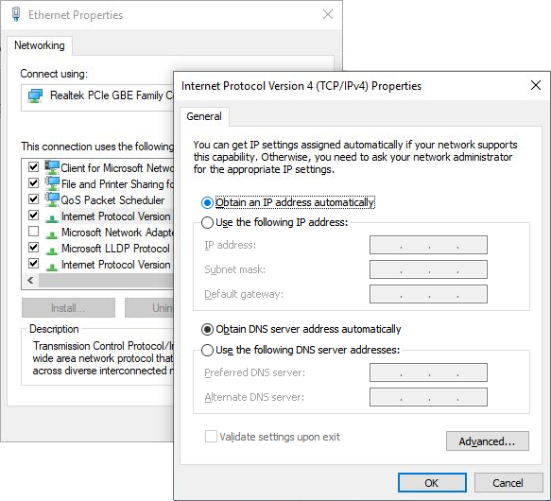
2. Network Configuration

Slide 11
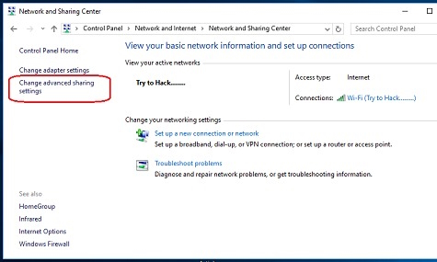
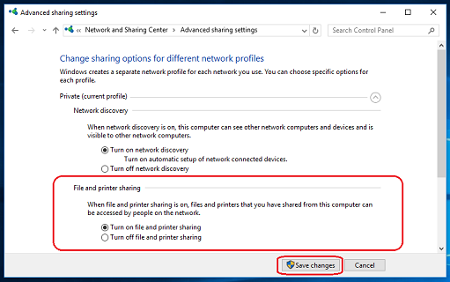
2. Network Configuration
4) Configure Network Discovery:
Go to "Network and Sharing Center".
Click "Change advanced sharing settings".
Ensure "Turn on network discovery" and "Turn on file and printer sharing" are enabled.

Slide 12
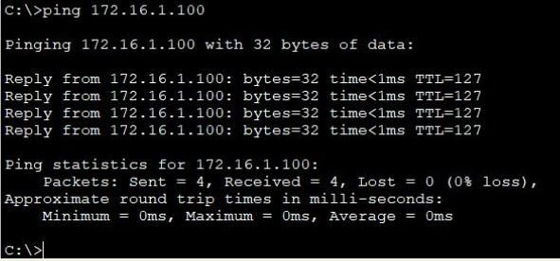
3. Testing the Network
1) Check Connections:
Ensure all Ethernet cables are securely connected.
Verify that the network hub is powered on and its status LEDs indicate active connections.
2) Ping Each Computer:
Open Command Prompt (CMD) or Terminal.
Use the ping command to test connectivity

Slide 13
Additional Steps (Troubleshooting)
Check Cable Connections: Ensure all Ethernet cables are securely connected to both the computers and the hub.
Check IP Configuration: Verify that each computer has a unique IP address within the same subnet.
Disable Firewalls Temporarily: Firewalls can sometimes block network discovery and sharing. Temporarily disable them to see if this resolves the issue.
Check Network Discovery Settings: Ensure that network discovery and file sharing are enabled on all computers.
Restart Devices: Sometimes, simply restarting the computers and the hub can resolve connectivity issues.

Slide 14
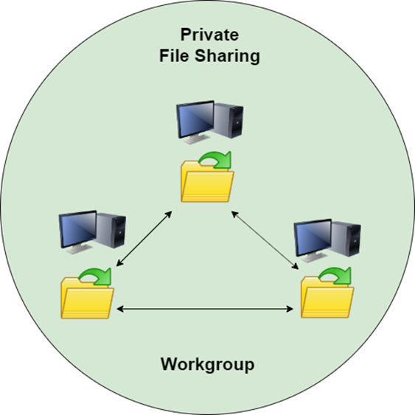
File Sharing
Sharing Resources:
Right-click a folder, select "Properties", go to the "Sharing" tab, and click "Share".
Access Shared Resources:
Open File Explorer, go to "Network", and locate other computers.

Slide 15
THANK YOU

